Slide 1
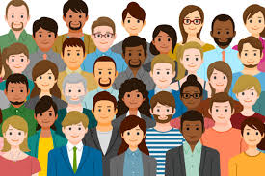
Diversity of Appearance

Slide 2
Daniel Kaschak and Hunter Hayek
Created By:

Slide 3
What We Didn’t Know
Employers have the right to dictate certain areas of their employee's appearance, but cannot infringe on certain protected rights (Daniel)
People are discriminated against for how attractive they appear to be or not (Daniel)
Religion has a large role in diversity of appearance because people often wear symbols of their beliefs(Daniel)
While Muslims comprise less than two percent of the American population, they accounted for approximately one quarter of the religious discrimination claims filed with the Equal Employment Opportunity Commission during 2009. (Hunter)
Ethnically diverse companies are 35% more likely to outperform their respective national industry medians. (Hunter)
Diversity fosters more creativity and innovation in the workplace.(Hunter)
If your employer is equal in firing people based on a specific aspect of their appearance, then in most cases, they can get away with doing it. (Hunter)

Slide 4
What Shouldn't Be Missed
There is almost no existing federal or state legislation that protect obese individuals faced with discrimination in the workplace
There is a very limited number of groups advocating for diversity of appearance in comparison to the other aspects of diversity & inclusion
Corporate appearance policies do not allow enough room for employees to express themselves based on ideals such as sexual orientation or religion
Notes:
If more attention was brought to the diversity of company's employees there can possibly be new ways to allow these employees to express themselves. This leads to more effective problem-solving, an increase in group/team chemistry and overall efficiency.
Without diversity, equity and inclusion we limit our talent, resources and the business opportunities necessary to thrive in an increasingly competitive global marketplace.
Legislation to put protections in place based on appearance will make the workplace more comfortable for all individuals, while organizational appearance policies will allow people to work for a company that is accepting to everyone's identity.
Appearance advocacy groups cannot make changes to the way society operates by themselves and need individual businesses to push their message forward to create more diverse and inclusive places of employment.

Slide 5
Social Justice Issues

Slide 6
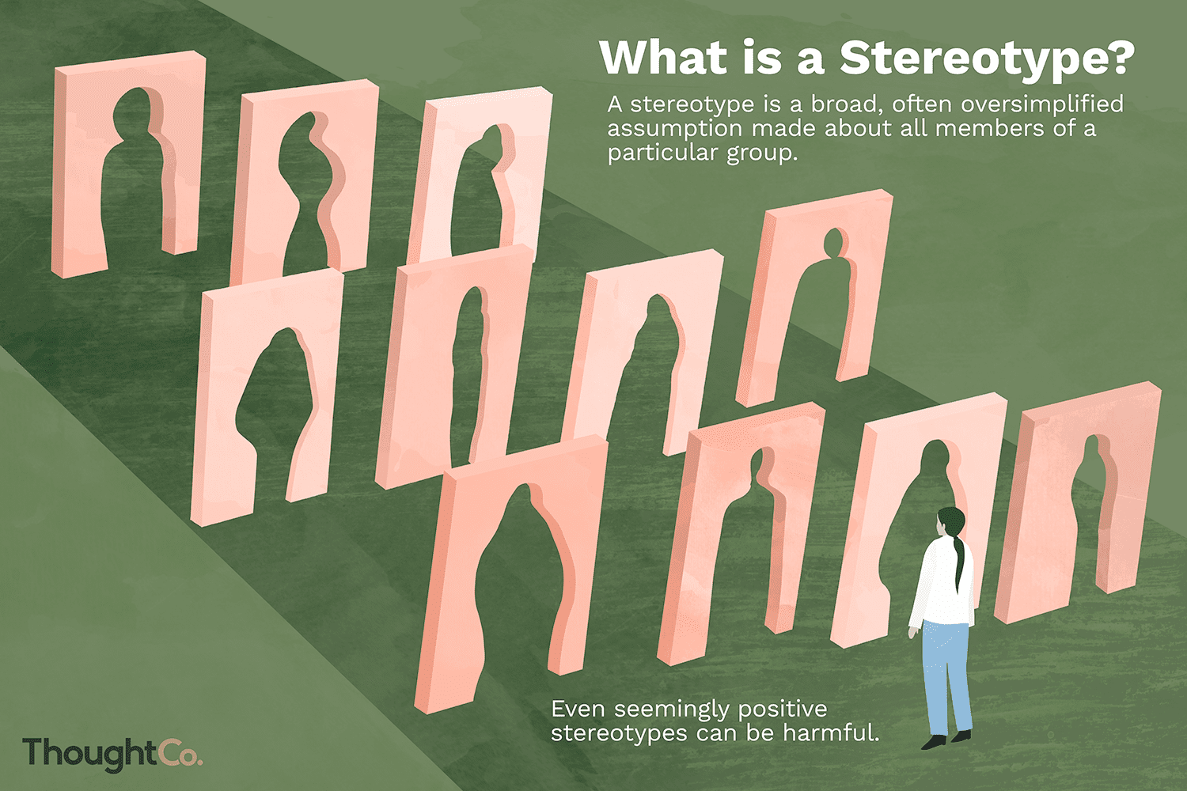
Societal Stereotypes
Obese people are "lazy, unmotivated, sloppy and lacking in discipline"
"Attractive people are more honest, successful and trustworthy"
"Being taller will make somebody a better employee than someone who is short"
"If you have a beard, that means that you do not take care of yourself properly"
Notes:
Obese people are often seen as not taking care of themselves because they look differently from the "social norm". This often affects woman much more prominently than it does men.
The reality is often that people who are over-weight may have health issues or other mental factors that lead them to being obese than just being too lazy to exercise or take care of themselves.
Attractive people are often given the benefit of the doubt regarding their level of skill and honesty in the workplace, even though there may be no information supporting those notions
-Attractiveness has not been proven to have any influence on positive character attributes than "less-attractive people," yet attractive people earn around $230,000 more on average over the course of their lifetime.
Taller people are often awarded more positive characteristic as apposed to the short people because society views being tall as an advantage.
-This is one of the most under-addressed issues in terms of discrimination because people do not realize that they have an implicit bias towards taller people.
Men with beards are often thought of as lacking in personal hygiene or it is believed that they do less to maintain themselves
-Most men with facial hair practice better hygiene and maintenance than that of their beard-less counterparts

Slide 7
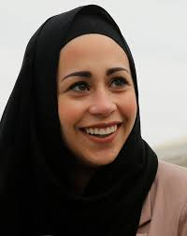
Exclusion, Discrimination and Inequalities Overview
Less attractive individuals are less likely to be selected for management training as well as promotions
Multiple studies have proven that makeup can increase women's "likeability", "trustworthiness" and "competence".
Black women are forced to change their appearance to fit in with social norms, an example of which is being told to straighten their hair
Signs of religion are often infringed upon in the workplace
An example of this is the woman who was denied employment at Abercrombie & Fitch because she was wearing a Hijab
10% of women and 5% of men have reported facing workplace discrimination because of their weight
Samantha Elauf: Succeeded in lawsuit against Abercrombie & Fitch in front of the U.S Supreme Court after having case thrown out in federal district court
Notes:
A commonly believed stereotype is "what is beautiful is good," which can lead to inequality based on "lookism" throughout many levels of society:
- More attractive college students are more likely to receive leadership positions and go on more dates
- Attractive people are more likely to be hired for positions and offered promotions to hire level positions within the workplace
Different cultures bring various benefits to the workplace and policies that force people to change their appearance to fit in with the dominant culture do not allow individuals from under-privileged groups to be comfortable with themselves in the workplace and thrive as the result of their diverse experiences.
- Many people are also forced to "cover" who they are because they believe that if they can assimilate into the larger group, they are more likely to be successful than if they stand out
as a more diverse individual
Religion has been an issue brought up for many years as everybody has different beliefs and ways that they show those beliefs.
- Although there are protections offered for religion under the 1964 Civil Rights Act, people are often treated differently based on how their religion affects their appearance.
- "The EEOC says Muslims file more employment claims about discrimination and the failure to provide religious accommodations than any other religious group."
Women are more likely to be judged based on their appearance than men, which is illustrated by the higher percentage of women reporting discrimination because of their weight.
- A 2016 study found that male job interviewers judged overweight female candidates more harshly than overweight male candidates

Slide 8
Legal Protections & Allies

Slide 9
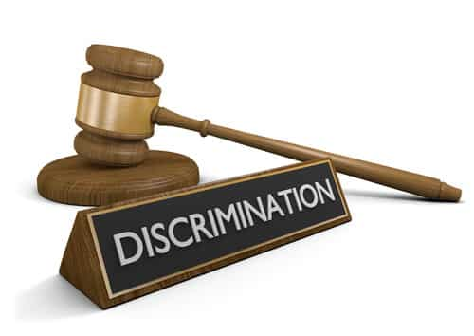
Laws and Accepted Policies
There are currently no federal laws in place that specifically protect individuals from workplace discrimination based on appearance
However, diversity of appearance can be included in some other laws
Title VII: Americans with Disabilities Act (ADA) and Age Discrimination in Employment Act (ADEA)
The 1964 Civil Rights Act can also offer protection to employees if an employer discriminates against them based on a characteristic such as religion
There are some state laws that offer protections based on appearance:
Michigan offers legal protections against discrimination based on height and weight
Washington D.C protects against employers discriminating for any reason based on appearance
Notes:
It is unfortunate that there are no laws in place to protect individuals from workplace discrimination based on appearance only. This means that you could lose your job because of your weight and have no recourse unless you have a documented medical condition that can be proof of wrongful termination.
If your employer feels that you are too attractive or unattractive, you could be fired or denied a promotion without the employer having to provide reasoning for why you lost your job.
Lawmakers could follow suit of the ADA or ADEA and offer protections on the state or federal level for people who are being discriminated against because they simply look different than the dominant culture in the workplace.
In order to foster inclusive environments, employers should also create organization policies that are accepting of people who appear to be different.

Slide 10


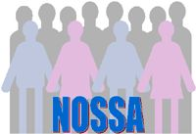
Advocacy Groups
One of the most important groups advocating for diversity of appearance is the Equal Employment Opportunity Commission (EEOC).
This group stands to protect those who are discriminated against for a variety of factors which include, but are not limited to: race, age, gender identity, religion, and other physical or mental characteristics during hiring, firing, promotions, harassment and training.
Discrimination related to diversity of appearance can be resolved through litigation which can be witnessed in the case of Samantha Elauf (Religious lawsuit against Abercrombie & Fitch).
Also aids federal agencies to meet EEOC guidelines.
The largest advocacy group for individuals suffering from obesity is the Obesity Advocacy Coalition (OAC).
This organization was established to inform people about obesity and its treatments, elevate the conversation about the health impacts of obesity and eliminating weight bias and discrimination.
One of the main purposes of this advocacy group is to educate employers about why obesity should be characterized as a disease as well as why treatment should be covered through the employer's medical programs
Also takes early action to fight against childhood obesity.
The National Organization of Short Statured Adults (NOSSA) was an organization that is no longer existing, but in the past advocated against discrimination towards shorter people.
NOSSA provided legal assistance for cases of discrimination based on height regarding employment, housing,
This was the result of only one state (Michigan) providing protections against height-based discrimination
NOSSA was forced to end its advocacy against "heightism" due to a lack of support and funding.
Notes:
These three advocacy groups do a wonderful job trying to protect and bring individuals to justice who have been harmed by discrimination or bias towards them as the result of their different appearance.
All three of these organizations have their own specific area in which they attempt of affect change, the EEOC focusing on employment for all people, the OAC advocating for individuals harmed by obesity, and the NOSSA fighting against heightism-Discrimination against someone because their height
Obesity affects millions of people around the world, but too often it is misunderstood, misjudged and stigmatized. WeightoftheWorld.com was created to bring about change powered by the ones who live with the challenges of obesity every day. Their stories give a face, a voice and a name to a disease that is often expressed in statistics and surrounded by stigma.
OAC advocates for obesity to be defined as a disease and for medical coverage to be offered as a benefit of employment for treatment and therapeutics in order to combat the problem.
(NOSSA) was an American non-profit advocacy group for adults of short stature. The organization clearly defined "short stature" to be men 170 cm (5'7") or below and women 157.5 cm (5'2") or below in height. This was a big problem when it was founded in 2005.

Slide 11
In Today's Workplace

Slide 12
What do Employees Desire and Need?
Equal employment opportunities and the ability for individuals to reach management positions, despite differences of appearance
The ability of members of non-dominant cultures to be themselves in the workplace and represent their culture without facing discrimination
Workplace policies that address differences between people and protect those differences while encouraging diversity
These policies could either be at an organizational or a legislative level
Possibly the most important change that needs to occur is reform to corporate appearance policies so that employees do not feel the need to “cover” their true identities
Notes:
Making diversity an integrated goal of companies will allow for direct steps to be taken by those organizations that prove to their employees that they are trying to be more inclusive and not just pushing the idea of diversity into the background.
Have a good mix of inherent and acquired diversity. While some larger businesses may have specific standards for their preferred mix of the two types of diversity, most workplaces don’t need such strict requirements.
Make sure there is diversity in management by creating leadership programs for people who are commonly discriminated against based on appearance as well as hiring programs that are directed at providing opportunities for under-privileged people.
Some businesses use diversity to connect with their customers, using outward diversity to make sure they appear visually diverse to customers who may face discrimination based on appearance themselves and want to patronize a company that understands and attempts to solve those same issues.
Failing to fulfill these needs and desires of employees could lead to negative affects for both the company and individual employees. Without policies and programs that encourage diversity and inclusion, discrimination will continue to be a problem through workplaces in the United States.

Slide 13
Institutional and/or Interpersonal Opportunities for Equity & Inclusion
Employers can alter corporate appearance policies to recognize the differences between certain groups of employees in the workplace, allowing for non-dominant groups to feel included
This change in policy would create a more diverse work environment by:
Allowing religious individuals to wear clothing that represents their beliefs,
Encouraging obese individuals to feel comfortable about their weight
Showing people from non-dominant cultures that they do not need to “cover” their appearance to fit in
Organizations can adopt hiring and promotion policies that give opportunities to all individuals no matter their attractiveness, body size, age, etc.
By showing that opportunities are available to every employee, people from underprivileged groups will feel empowered to strive for positions with more responsibilities
Notes:
Corporate appearance policies limit the amount of diversity that can be introduced to a specific company. The ability for all people to represent themselves in the way they look or to be able to be included despite having some difference of appearance is important for a healthy work environment.
Religious individuals have been affected by these appearance policies because they limit the clothes that people can wear to show their identity and culture at work. Obese people are affected differently by strict appearance policies because they may be ostracized because of a health condition that might be out of their control.
Forcing people to fit into the dominant culture will lead to them feeling under-appreciated, unaccepted, or left out if they fail to do so or decide that they want to maintain their identity and self of individuality.
Giving employees of all different appearances the ability to advance in the company will show that organizations can accept their employees no matter what differences they have in order to create an inclusive and productive environment around them.

Slide 14
Interesting Issues about Dimensions

Slide 15
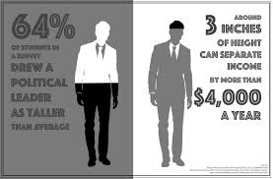
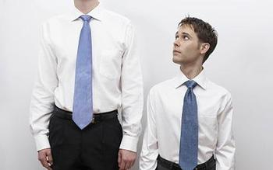
Subtopic: Heightism in the Workplace
Most of the discrimination based on height in the workplace is legal throughout the United States
One important factor is that most heightism results from subconscious bias which can take the form of ridicule or jokes
There are three main problems that are the result of height-based discrimination:
Less leadership opportunities for shorter individuals
Lower salaries for those being discriminated against
Managers and coworkers exclude shorter employees
With advancing technology and the internet making remote work available, heightism is beginning to become less prominent in the workplace due to a decrease in coworker interactions
Little people are often the ones most affected by heightism, as commonly used offensive terms include “midget” or “dwarf”
Notes:
Most height discrimination is subconscious bias, behind closed doors, behind your back, or in text / email / water-cooler jokes... and its all completely legal. But that is where it starts.
The internet has become a great equalizer for shorter people and anyone else that may face some level of height discrimination or other discrimination based on appearance. The better software, laptops, smartphones, cell phone signals, and Wi-Fi strength get means less in-person business and reduced potential height discrimination.
Very tall men 6'6" or taller and women over 6' can stand out among other employees and can become the targets of jokes or stereotypes as well. Height discrimination can even more significantly hurt much taller women since they may stand out more, and some men may be threatened by their stature.

Slide 16
Thoughts In Relation to the Topic
Height should not be a factor in determining whether an individual should receive a job offer or a promotion
States should recognize height as a characteristic that is protected from discrimination in the workplace
This is especially true for little people who have legitimate medical issues that affect their height
While it is a good sign that the levels of height discrimination may be dropping, it should not take having to work remotely for these changes to occur
If organizations want to become more diverse and inclusive, more people in leadership positions need to act when they are notified about employees discriminating against their peers because of his/her height
Notes:
Height discrimination has played a significant role in the hiring/ promotion process over the past few years due to the stereotype that taller people will be more effective workers and leaders.
Legislation to protect individuals against heightism in the workplace would stop discrimination against people who are shorter in stature or dealing with medical conditions that affect the size of their body.
New laws would also encourage employers to act within their organizations to protect themselves against legal ramifications due to discrimination. This can be accomplished by implementing training and sensitivity programs for employees, including management.
Workplaces being shifted to remote status for many companies has caused workplace discrimination due to heightism to decrease in relation to the number of people affected throughout the past.
Diversity of appearance is key to affected heightism in the workplace because if more individuals look differently that one another, nobody will feel like the odd-person out in the group. The result of this shift would also create a more inclusive environment where people with health problems or other differences can feel comfortable interacting with coworkers on a daily basis.

Slide 17
Bibliography

Slide 18
Resources Used to Develop the Presentation
Martin, Areva. “Weight Discrimination Is Legal in 49 States.” Time, Time, 16 Aug. 2017, time.com/4883176/weight-discrimination-workplace-laws/.
Hurley, Lawrence. “U.S. Top Court Backs Muslim Woman Denied Job over Head Scarf.” Reuters, Thomson Reuters, 1 June 2015, www.reuters.com/article/us-usa-court-scarf/u-s-top-court- backs-muslim-woman-denied-job-over-head-scarf-idUSKBN0OH2NW20150601.
“Heightism In The Workplace: How Height Discrimination Hurts Careers.” Bootstrap Business, 2018, www.myfrugalbusiness.com/2020/01/heightism-workplace-discrimination-shorter-men-career-lower-pay.html.
“The Story of the OAC.” Obesity Action Coalition, www.obesityaction.org/our-purpose/about-us/story/.
Rosenberg, I. B. (2009). Height Discrimination in Employment. Utah Law Review, (3), 907-953.
“Overview.” U.S. Equal Employment Opportunity Commission, www.eeoc.gov/overview.
Bruton, S. V. (2015). Looks-Based Hiring and Wrongful Discrimination. Business and Society Review: The Center for Business Ethics At Bentley College, 120(4), 607-635.
Cavico, F., Muffler, S., & Mujtaba, B. (2013). Appearance Discrimination in Employment: Legal and Ethical Implications of "Lookism" and "Lookphobia". Equality, Diversity and Inclusion, 32(1), 83-119.
Spahlholz, J., Baer, N., König, H., Riedel-Heller, S. G., & Luck-Sikorski, C. (2016). Obesity and Discrimination: A Systematic Review and Meta-Analysis of Observational Studies. Obesity Reviews, 17(1), 43-55.
Bandsuch, M. R. (2009). Dressing Up Title VII's Analysis of Workplace Appearance Policies. Columbia Human Rights Law Review, 40(2), 287-342.
https://www.learningtogive.org/sites/default/files/handouts/Interesting_Facts_about_American_Diversity.pdf
https://www.grandrapids.org/blog/news/5-facts-diversity-workplace/

Slide 19
Recommended Discussion Points

Slide 20
Questions For Our Learning Community
Would viewing obesity as a disease stop workplace discrimination and provide help to those struggling with it?
Is Diversity of Appearance as important as the other dimensions of diversity?
Is there anything else that companies can do to change how people of different heights are treated in the workplace?
Can you describe an organization that has taken direct steps toward placing an emphasis on diversity of appearance?
Do companies recruit based on the merit of each candidate or do they base their decisions on personal factors such as looks?

